Slide 1
Student Location Demographics
Scott Fisher

Slide 2
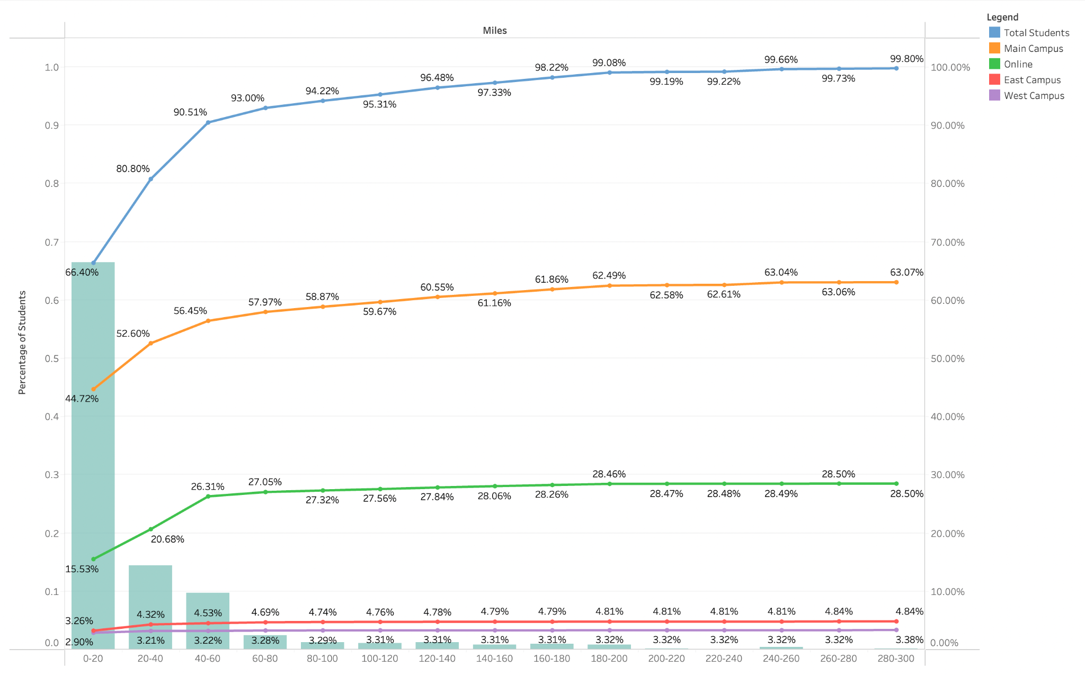
How far from campus do students live?
Bars represent the distances all students live from their respective campus. Lines are running totals of how many students live in the area around each campus with increasing radius.

Slide 3
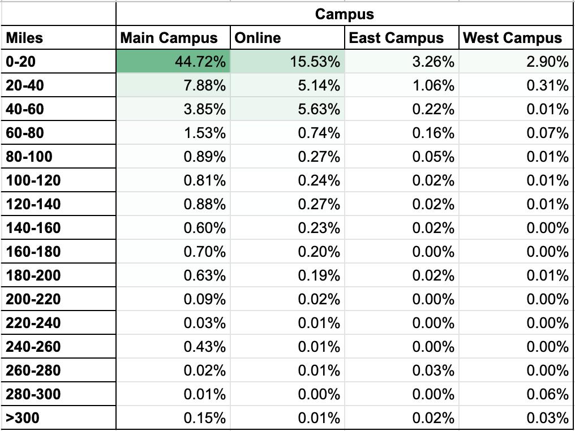
Display of total student body dispersion around each campus respectively

Slide 4
80% of students
Below are the distances for 80% of each student body
Main Campus - 40 miles
Online - 60 miles
West Campus - 20 miles
East Campus - 40 miles

Slide 5
Results
The majority of students live near campus.
A slight surprise:
Online students mostly live within 60 miles of campus.

Slide 6
Actions
Focus marketing for each campus program more heavily in these distances.
If the desire is to convert online students to physical, focus on marketing online program classes that are offered in-person to online students.
Market to online students that live within 40 miles.

Slide 7
Improvements
Add specific programs offered by each campus to the analysis. This way, distances are more accurate, and marketing info is more concise.

